Slide 1
La oficina de ROANYER
Lift tour of ROANYER office

Slide 3
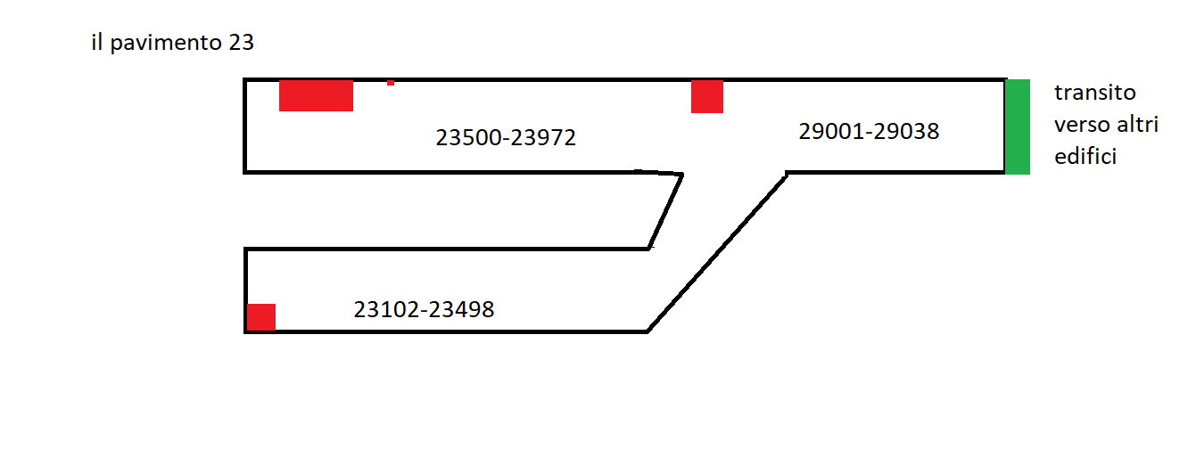

Slide 4
23

Slide 5
23

Slide 6
9
0
7
8
NFC reader
5
6
3
4
1
2
,

Slide 7
23
Sigma elevator inc.
Estimated for 12 persons or 1100 kgs

Slide 8
24
Sigma elevator inc.
Estimated for 12 persons or 1100 kgs

Slide 9
24.5
Sigma elevator inc.
Estimated for 12 persons or 1100 kgs

Slide 10
25
Sigma elevator inc.
Estimated for 12 persons or 1100 kgs

Slide 11
25.2
Sigma elevator inc.
Estimated for 12 persons or 1100 kgs

Slide 12
25.4
Sigma elevator inc.
Estimated for 12 persons or 1100 kgs

Slide 13
25.6
Sigma elevator inc.
Estimated for 12 persons or 1100 kgs

Slide 14
25.8
Sigma elevator inc.
Estimated for 12 persons or 1100 kgs

Slide 15
26
Sigma elevator inc.
Estimated for 12 persons or 1100 kgs

Slide 16
26.5
Sigma elevator inc.
Estimated for 12 persons or 1100 kgs

Slide 17
27 1/3
Sigma elevator inc.
Estimated for 12 persons or 1100 kgs

Slide 18
27 2/3
Sigma elevator inc.
Estimated for 12 persons or 1100 kgs

Slide 19
28
Sigma elevator inc.
Estimated for 12 persons or 1100 kgs

Slide 20
32
Sigma elevator inc.
Estimated for 12 persons or 1100 kgs

Slide 21
34.232
Sigma elevator inc.
Estimated for 12 persons or 1100 kgs

Slide 22
34.9
Sigma elevator inc.
Estimated for 12 persons or 1100 kgs

Slide 23
36
Sigma elevator inc.
Estimated for 12 persons or 1100 kgs

Slide 24
38
Sigma elevator inc.
Estimated for 12 persons or 1100 kgs

Slide 25
39½
Sigma elevator inc.
Estimated for 12 persons or 1100 kgs

Slide 26
40
Sigma elevator inc.
Estimated for 12 persons or 1100 kgs

Slide 27
40½
Sigma elevator inc.
Estimated for 12 persons or 1100 kgs

Slide 28
40½

Slide 30
40½

Slide 31
40½
23
21
20½
19½
18.2

Slide 32
40½

Slide 33
23

Slide 34
21

Slide 35
20½

Slide 36
19½

Slide 37
18 1/5

Slide 38
18 1/5

Slide 41
23
18.5
17
15
13
E

Slide 42
18.5

Slide 43
17

Slide 44
15

Slide 45
13

Slide 46
11.3

Slide 47
23
18.5
17
15
13
E

Slide 48
11.3

Slide 49
15

Slide 50
17

Slide 51
18.5

Slide 52
23

Slide 53
Edificio 82-83
97.2
4-5
Edificio 4-5 1 min

Slide 54
Edificio 82-83
97.2
4-5
Edificio 4-5 0 min

Slide 55
Edificio 82-83
97.2
4-5
Edificio 4-5 0 min

Slide 56
Edificio 82~83

Slide 57
Next stop building 85 - Prossima fermata edificolo 85 - Próxima parada edificio 85

Slide 58
Next stop building 85 - Prossima fermata edificolo 85 - Próxima parada edificio 85

Slide 59
building 85 - edificolo 85

Slide 60
building 85 - edificolo 85
Transit to building 5v via headquater

Slide 61
building 85 - edificolo 85
Transit to building 5v via headquater

Slide 62
Next stop building 82 - Prossima fermata edificolo 82 - Próxima parada edificio 82

Slide 63
Next stop building 82 - Prossima fermata edificolo 82 - Próxima parada edificio 82

Slide 64
building 82 - edificolo 82
Transit to building 5v via headquater

Slide 65
building 82 - edificolo 82
Transit to building 5 via headquater

Slide 66
Next stop building 80 - Prossima fermata edificolo 78 - Próxima parada edificio 78

Slide 67
Next stop building 78 - Prossima fermata edificolo 78 - Próxima parada edificio 78

Slide 68
building 78 - edificolo 78
Transit to building 5v via headquater

Slide 69
building 78 - edificolo 78
Transit to building 5 via headquater

Slide 70
Next stop building 75 - Prossima fermata edificolo 75 - Próxima parada edificio 75

Slide 71
Next stop building 75 - Prossima fermata edificolo 75 - Próxima parada edificio 75

Slide 72
building 75 - edificolo 75
Transit to building 5v via headquater

Slide 73
building 75 - edificolo 75
Transit to building 5 via headquater

Slide 74
Next stop building 73~71 - Prossima fermata edificolo 73~71 - Próxima parada edificio 73~71

Slide 75
Next stop building 73~71 - Prossima fermata edificolo 73~71 - Próxima parada edificio 73~71

Slide 76
building 73~71 - edificolo 73~71
Transit to building 5v via headquater

Slide 77
building 73~71 - edificolo 73
Transit to building 5 via headquater

Slide 78
Next stop building 65 - Prossima fermata edificolo 65 - Próxima parada edificio 65

Slide 79
Next stop building 65 - Prossima fermata edificolo 65 - Próxima parada edificio 65

Slide 80
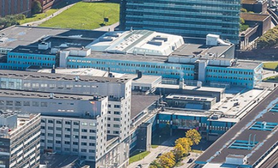
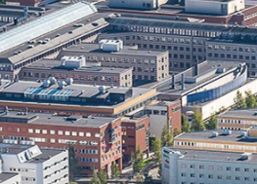
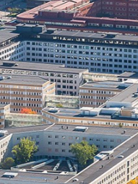
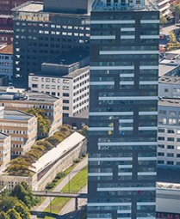
Next stop building 65 - Prossima fermata edificolo 65 - Próxima parada edificio 65

Slide 81
building 65 - edificolo 65
Transit to building 5v via headquater

Slide 82
building 65 - edificolo 65
Transit to building 5 via headquater

Slide 83
Next stop building 61 - Prossima fermata edificolo 61 - Próxima parada edificio 61

Slide 84
Next stop building 61 - Prossima fermata edificolo 61 - Próxima parada edificio 61

Slide 85
building 61 - edificolo 61
Transit to building 5v via headquater

Slide 86
building 61 - edificolo 61
Transit to building 5 via headquater

Slide 87
Next stop building 59 - Prossima fermata edificolo 59 - Próxima parada edificio 59

Slide 88
Next stop building 59 - Prossima fermata edificolo 59 - Próxima parada edificio 59

Slide 89
building 59 - edificolo 59
Transit to building 5v via headquater

Slide 90
Stand clear!!! Doors Closing!!
Transit to building 5 via headquater

Slide 91
Next stop building 50 - Prossima fermata edificolo 50 - Próxima parada edificio 50

Slide 92
Next stop building 50 - Prossima fermata edificolo 50 - Próxima parada edificio 50

Slide 93
building 50 - edificolo 50
Transit to building 5v via headquater

Slide 94
Stand clear!!! Doors Closing!!
Transit to building 5 via headquater

Slide 95
Next stop building 37E - Prossima fermata edificolo 37E - Próxima parada edificio 37E

Slide 96
Next stop building 37E - Prossima fermata edificolo 37E - Próxima parada edificio 37E

Slide 97
building 37E – edificolo 37E
Transit to building 5v via headquater

Slide 98
Stai alla larga !!! Chiusura porte !!
Transit to building 5 via headquater

Slide 99
Next stop building 37 B C D - Prossima fermata edificolo 37 B C D - Próxima parada edificio 37 B C D

Slide 100
Next stop building 37B C D - prossima fermata edificolo 37 B C D - Próxima parada edificio 37 B C D

Slide 101
edificolo 37B,C,D
Transit to building 5v via headquater

Slide 102
Stand clear!!! Doors Closing!!
Transit to building 5 via headquater

Slide 103
prossima fermata edificolo 35, 32

Slide 104
Next stop building 32 - Prossima fermata edificolo 32 - Próxima parada edificio 32

Slide 105
edificolo 35,32
Transit to building 5v via headquater

Slide 106
Stai alla larga !!! Chiusura porte !!
Transit to building 5 via headquater

Slide 107
Next stop headquater building - Prossima fermata edificolo quartier generale - Próxima parada edificio de la sede

Slide 108
prossima fermata edificolo quartier generale

Slide 109
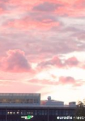
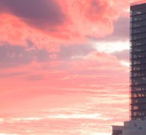

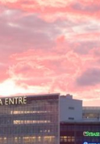
prossima fermata edificolo quartier generale

Slide 110
prossima fermata edificolo quartier generale

Slide 111
quartier generale, il transito rimarrà qui almeno 1 minuto

Slide 112
Stai alla larga !!! Chiusura porte !!
Transit to building 5

Slide 113
Stai alla larga !!! Chiusura porte !!
Transit to building 5

Slide 114
Next stop building 4½ - prossima fermata edificolo 4½ - Próxima parada edificio 4½

Slide 115
Next stop building 4½ - Prossima fermata edificolo 4½ - Próxima parada edificio 4½

Slide 116
edificolo 4½ U
Transit to building 5v via he

Slide 117
Stai alla larga !!! Chiusura porte !!
Transit to building 5

Slide 118
Next stop building 5 - Prossima fermata edificolo 5 - Próxima parada edificio 5

Slide 119
Next stop building 5 - Prossima fermata edificolo 5 - Próxima parada edificio 5

Slide 120
edificolo 4½ U
Transit to building 5v via he

Slide 121
Stai alla larga !!! Chiusura porte !!
Transit to building 5

Slide 122
prossima fermata edificolo 4½

Slide 123
prossima fermata edificolo 4½

Slide 124
edificolo 4½
Transit to building 5v via he

Slide 125
Stai alla larga !!! Chiusura porte !!
Transit to building 5

Slide 126
prossima fermata edificolo 5

Slide 127
prossima fermata edificolo 5

Slide 128
edificolo 5
Transit to building 5v via he

Slide 129
Scendi da questo transito
<- Transit to 97 via headquaters

Slide 130
Edificio 4-5
via d'uscita
Transit á edificio 97.5 ->
<- la reception de Edificio 4-5
non calpestare questo transito

